Slide 1
Type conversions
In C when constants and variables of different types are mixed in an
expression, C applies automatic type conversion to the operands as per its
rules. Type conversions of built in data types are automatic e.g.
int m ; float x = 3.14;
m = x;
m = 3;
Here, ‘x’ is first converted to an integer before its value is assigned to ‘m’.
The same concept of type conversion can also be applied to user
defined data types like classes of different types apart from basic data
types.
Three types of data conversion between uncompatible types:
Conversion from basic (meter) type to class (Distance with feet and inches) type
Conversion from class (Distance with feet and inches) type to basic (meter)type
Conversion from one class (Celsius) type to another class (Fahrenheit) type

Slide 2
i. Conversion from Basic type to Class type
Converting duration to Time
class Time{
int hour,min;
public:
Time(){}
Time(int d){ //int to Time object conversion
hour = d/60; min = d%60;
}
void showTime(){
cout << hour <<” ”<< min;
}
};
void main(){
Time t1; int duration=81;
t1 = Time(duration); // type conversion here
t1.showTime();
}

Slide 3
i. Conversion from Basic type to Class type
Converting character to String class
class String{
char name[10];
public:
String(){}
String(char nam[]){ //char converted to String
strcpy(name, nam);
}
void showString(){
cout << name;
}
};
void main(){
String s1;
char s2[] = "deekep";
s1 = String(s2); // type conversion here
s1.showString();
}

Slide 4
i. Conversion from Basic type to Class type
Conversion from basic type to class type e.g. building a vector object from an int type array or
building a string type object from a char* type variable is done using constructors. Here, the
constructor performs a type conversion from the argument’s type (basic) to the constructor’s
class type.
Converting meter to Distance class
class Distance{
float feet, inches;
public:
Distance(){}
Distance(float meter){
float ft = meter *3.28;
feet = int (ft);
inches = 12 * (ft -feet);
}
void display(){
cout << feet << "feet"<<inches<< " inches";
}
};
void main(){
float meter = 8;
Distance d;
d = meter;
d.display();
}

Slide 5
ii. Conversion from Class type to Basic type
Constructor functions do not support this operation , C++ allows defining casting
operator that is used to convert a class type data to a basic type. The syntax of an
overloaded casting operator function also known as
conversion function is as follows:
operator typename(){
-----------
}
The conversion function:
-Must be a class member
-Must not specify a return type
-Must not have any arguments
This function converts a class type data to typename e.g.
operator double() converts a class object to double type
operator int() converts a class type object to int type

Slide 6
ii. Conversion from Class type to Basic type
Converting from Item class to value (float)
class item{
int quantity; int price;
public:
item(){
quantity =100; price=9;
}
operator float(){ //conversion function
return(quantity * price);
}
};
main(){
item itm1;
float value;
value = float(itm1); //conversion here
cout << value;
}

Slide 7
ii. Conversion from Class type to Basic type
Conversion from Distance to Meter
class Distance{
private:
float feet, inches;
public:
Distance(float ff, float ii){feet =ff; inches = ii;}
operator float(){
float mm;
mm = inches /12;
mm = feet +mm;
return mm/3.28876;
}
};
int main()
{
Distance d(7,8);
float m =d;
cout <<m;
return 0;
}

Slide 8
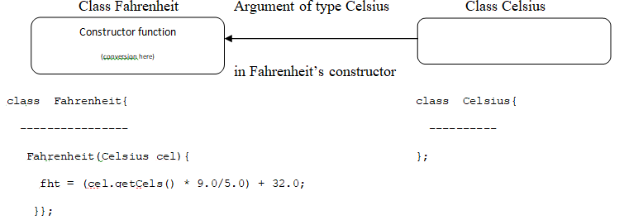
iii. Conversion from one Class type to another Class type
Conversion between objects of different classes can be carried out by using either a constructor or a
conversion function.
In case of using a conversion function while converting from Class type to Basic type, we have seen that the
casting operator function operator typename( ); i.e. operator double( ) converts a class object to type double.
In case of conversion between objects, this type name refers to the destination class.
Using a Constructor
A single argument constructor function serves as an instruction for converting the argument’s type to the class
type of which it is a member
The argument to the constructor belongs the source class and is passed to the constructor of the destination
class for conversion. Hence, the conversion constructor must be placed in the destination class.
e.g. Fahrenheit = Fahrenheit(Celsius ); //Celsius is the source class

Slide 9
iii. Conversion from one Class type to another Class type
class Celsius{
float cels;
public:
Celsius(){ cels = 0;}
Celsius(float cc){
cels = cc;
}
float getCels(){
return cels;
}
};
class Fahrenheit{
float fht;
public:
Fahrenheit(){fht = 0;}
Fahrenheit(Celsius cel){
fht = (cel.getCels() * 9.0/5.0) + 32.0;
}
void show(){
cout << fht;
}
};
main(){
Celsius celsius(1.0);
Fahrenheit fahrenheit;
fahrenheit = Fahrenheit(celsius);
fahrenheit.show();
}

Slide 10
iii. Conversion from one Class type to another Class type
class Item2;
class Item1{
int quantity; float price;
public:
Item1(int q, float p){
quantity = q; price = p;
}
int getQuantity(){
return(quantity);
};
int getPrice(){
return(price);
}
};
class Item2{
int quantity; float cost;
public:
Item2(){}
Item2(Item1 i){
cost = i.getQuantity() *i.getPrice();
}
void show(){
cout << " Total Cost "<< cost;
}
};
void main(){
Item1 i(10,4.5);
Item2 ii;
ii = Item2(i); //object i of Item1 class is
ii.show(); //converted to object ii of Item2 class
}

